Slide 1
CS112: Introduction to Python programming
Week 14: Data Visualization II

Slide 2
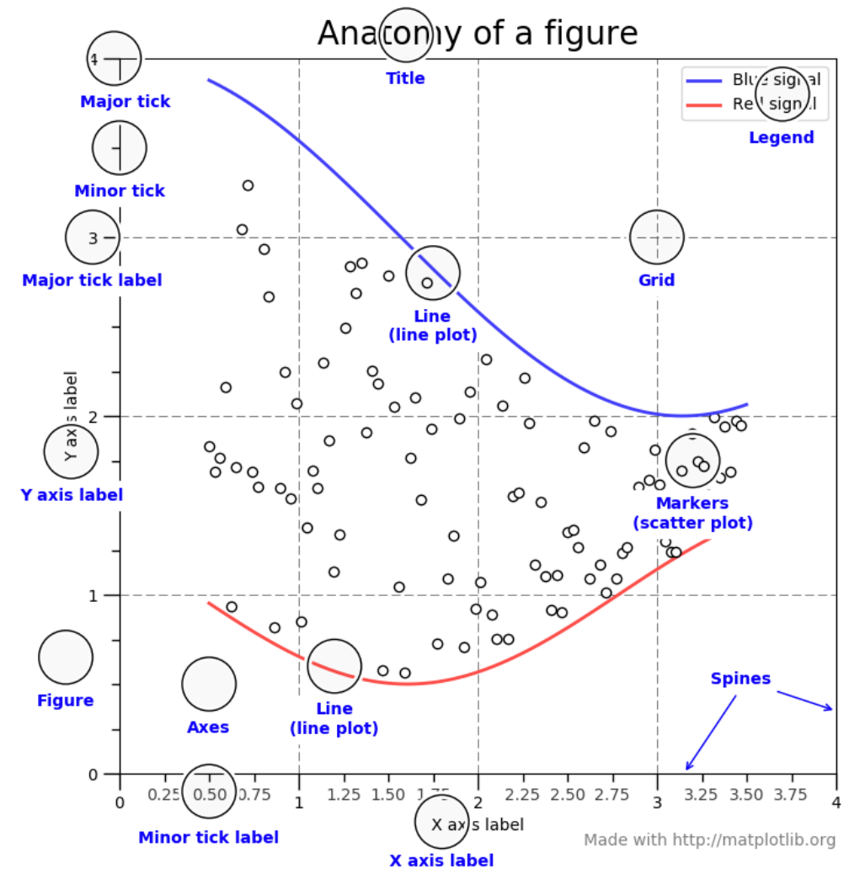
Parts of a Figure
class Figure
The whole figure. The figure keeps track of all the child class Axes
class Axes
This is what you think of as 'a plot', it is the region of the image with the data space.

Slide 3
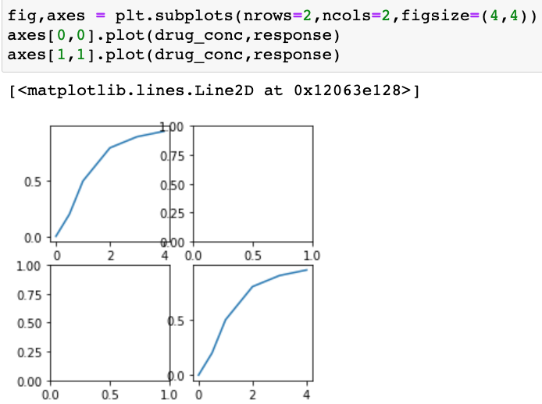
Multiple plots in one figure
plt.subplots( nrows=1, ncols=1)
Create a figure and a set of subplots axes;
Return a Figure and Axes

Slide 4
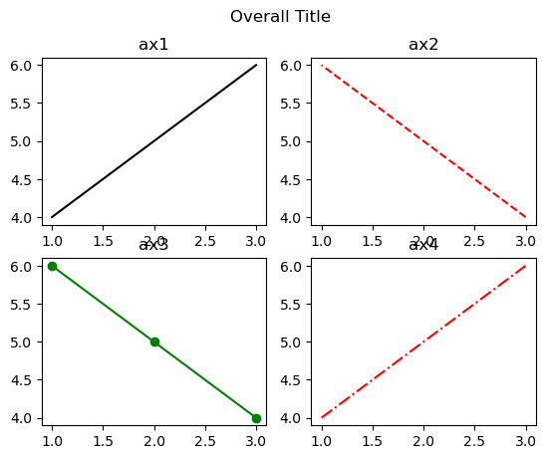
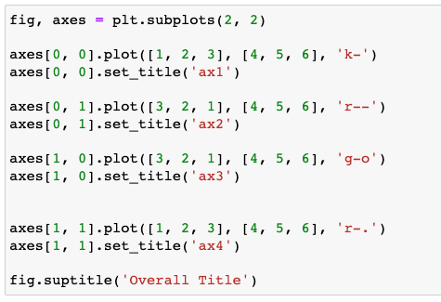
Multiple plots in one figure

Slide 5
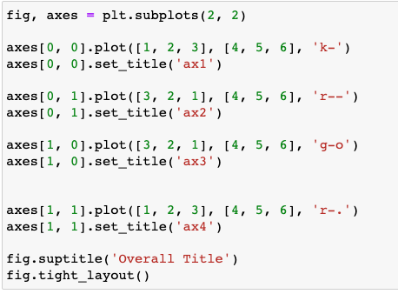
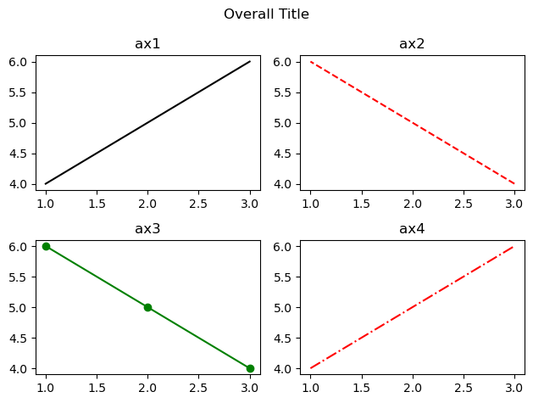
Multiple plots in one figure
fig.tight_layout(*, pad=1.08, h_pad=None, w_pad=None, rect=None)
Adjust the padding between and around subplots.

Slide 6
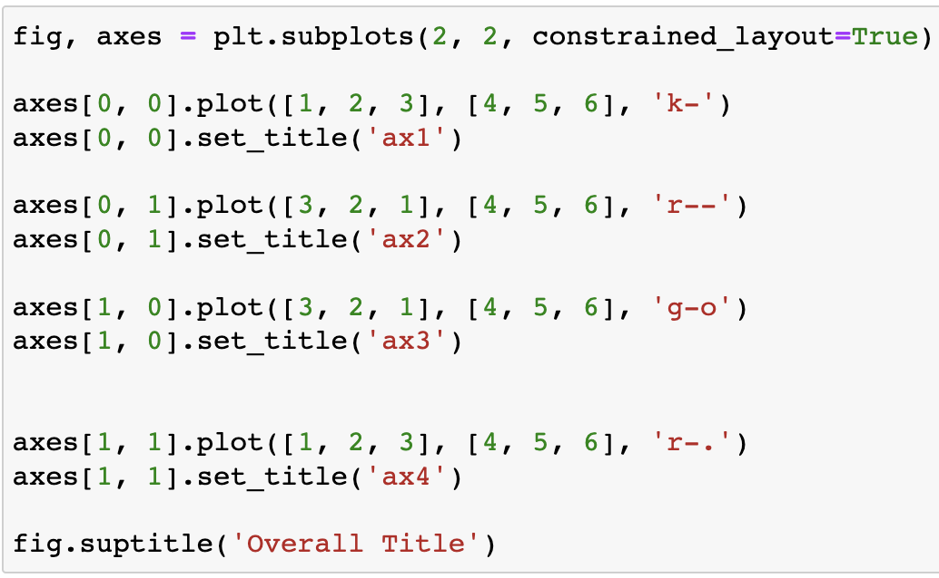
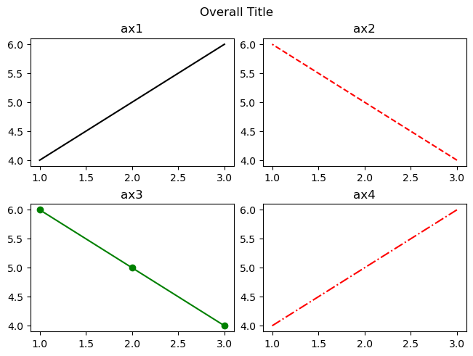
Multiple plots in one figure
Similar to tight_layout, constrained_layout automatically adjusts subplots and decorations like legends and colorbars so that they fit in the figure window while still preserving, as best they can, the logical layout requested by the user.

Slide 7
Multiple plots in one figure
Figure.add_subplot(*args, **kwargs)
Add an Axes to the figure as part of a subplot arrangement;
*args: int, (int, int, index), or SubplotSpec, default: (1, 1, 1)The position of the subplot described by one of three integers (nrows, ncols, index). The subplot will take the index position on a grid with nrows rows and ncols columns. index starts at 1 in the upper left corner and increases to the right. index can also be a two-tuple specifying the (first, last) indices (1-based, and including last) of the subplot, e.g., fig.add_subplot(3, 1, (1, 2)) makes a subplot that spans the upper 2/3 of the figure.
A 3-digit integer. The digits are interpreted as if given separately as three single-digit integers, i.e. fig.add_subplot(235) is the same as fig.add_subplot(2, 3, 5). Note that this can only be used if there are no more than 9 subplots.

Slide 8
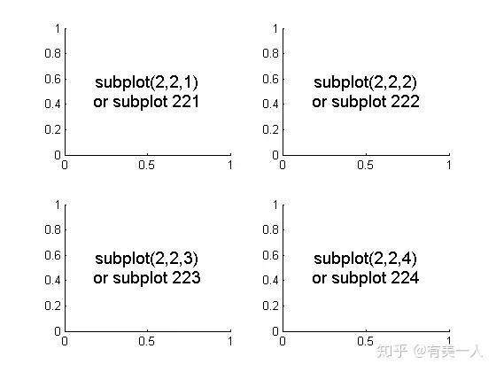
Multiple plots in one figure
Figure.add_subplot(*args, **kwargs)
More parameters
https://matplotlib.org/stable/api/figure_api.html#matplotlib.figure.Figure.add_subplot

Slide 9
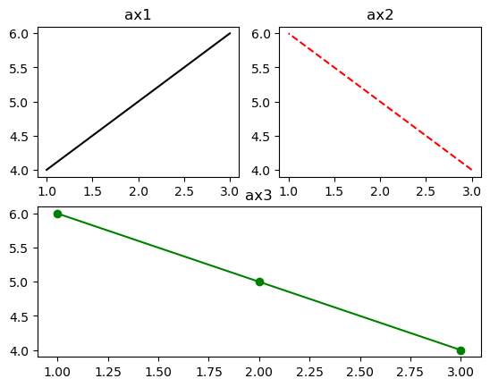
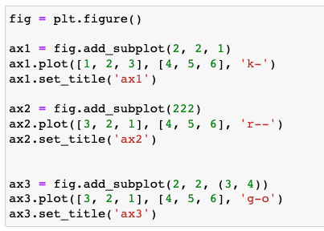
Multiple plots in one figure

Slide 10
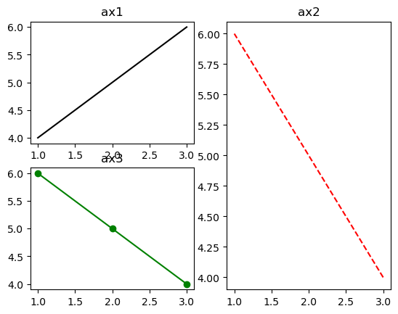
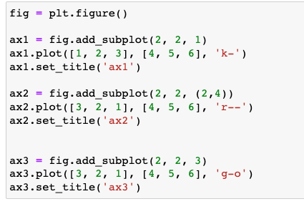
Multiple plots in one figure

Slide 11
Multiple plots in one figure
GridSpec: specifies the geometry of the grid that a subplot will be placed.
Multiple subplots using the GridSpec function. You can create the figure and GridSpec instance separately, then pass elements of gridspec instance to the add_subplot() method to create the axes objects. The elements of the gridspec are accessed in generally the same manner as numpy arrays.
The power of gridspec comes in being able to create subplots that span rows and columns, using the NumPy slice syntax for selecting the part of the gridspec each subplot will occupy.

Slide 12
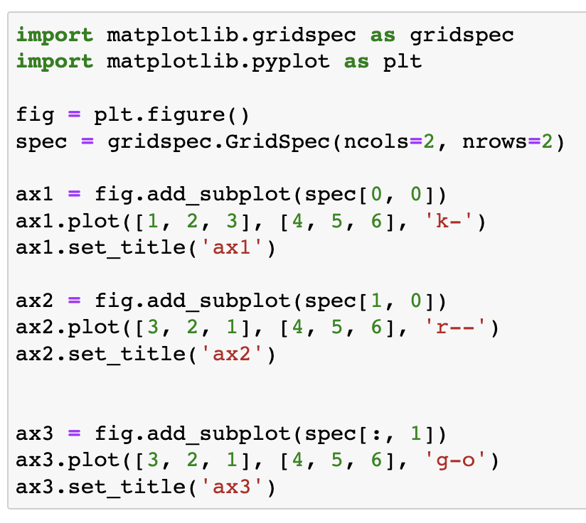
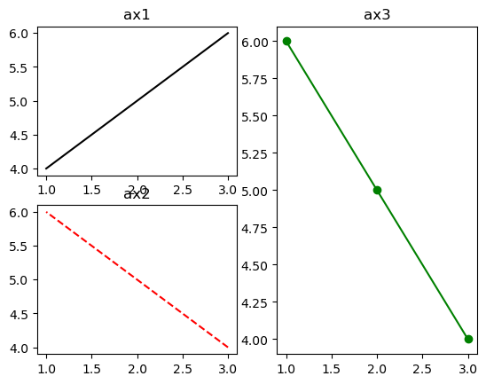
Multiple plots in one figure

Slide 13
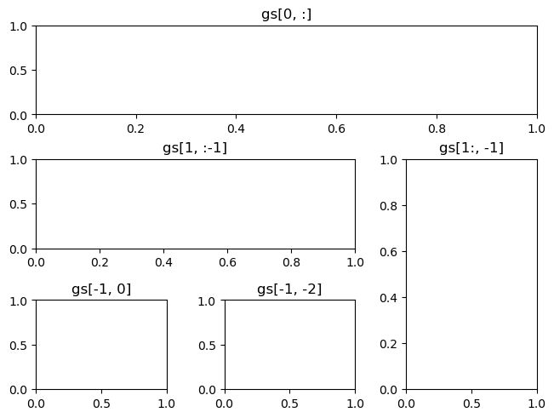
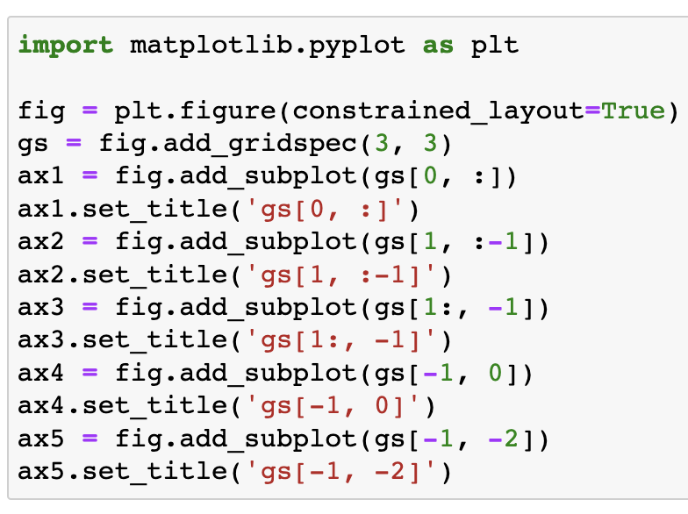
Multiple plots in one figure
We can also use the convenience method Figure.add_gridspec() instead of gridspec.GridSpec.

Slide 14
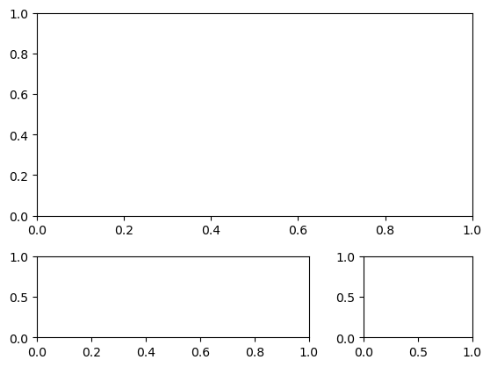
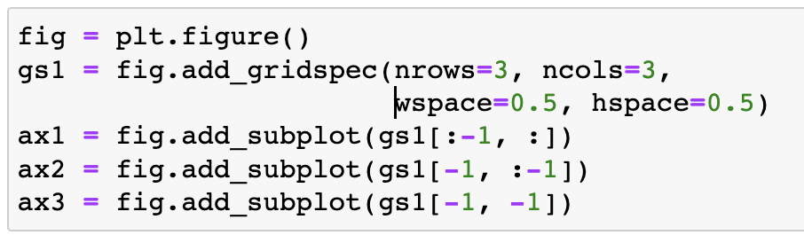
Multiple plots in one figure
When a GridSpec is explicitly used, you can adjust the layout parameters of subplots that are created from the GridSpec.
left, right, top, bottom float, optional Extent of the subplots as a fraction of figure width or height. Left cannot be larger than right, and bottom cannot be larger than top. If not given, the values will be inferred from a figure or rcParams at draw time.
wspace, hspace float, optional The amount of width/ height reserved for space between subplots, expressed as a fraction of the average axis width. If not given, the values will be inferred from a figure or rcParams when necessary.

Slide 15
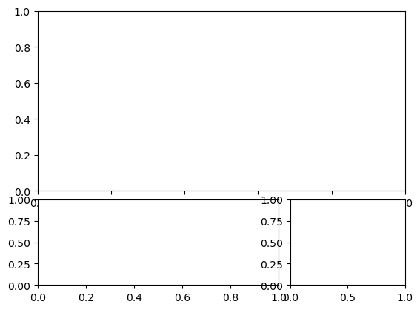
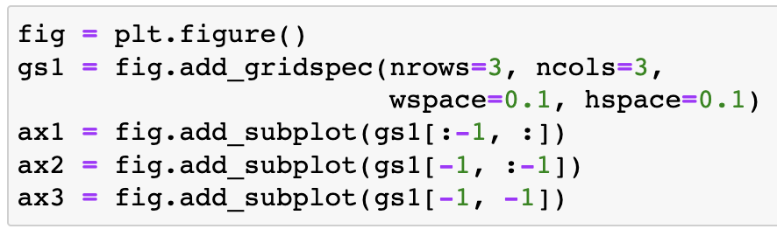
Multiple plots in one figure
When a GridSpec is explicitly used, you can adjust the layout parameters of subplots that are created from the GridSpec.
left, right, top, bottom float, optional Extent of the subplots as a fraction of figure width or height. Left cannot be larger than right, and bottom cannot be larger than top. If not given, the values will be inferred from a figure or rcParams at draw time.
wspace, hspace float, optional The amount of width/ height reserved for space between subplots, expressed as a fraction of the average axis width. If not given, the values will be inferred from a figure or rcParams when necessary.

Slide 16
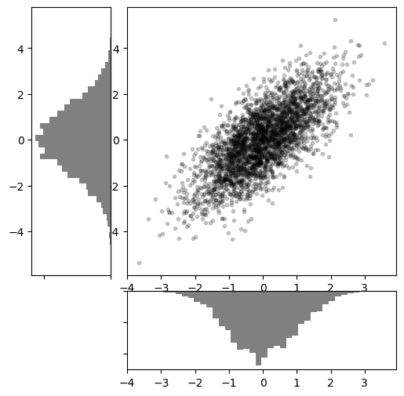
Multiple plots in one figure

Slide 17
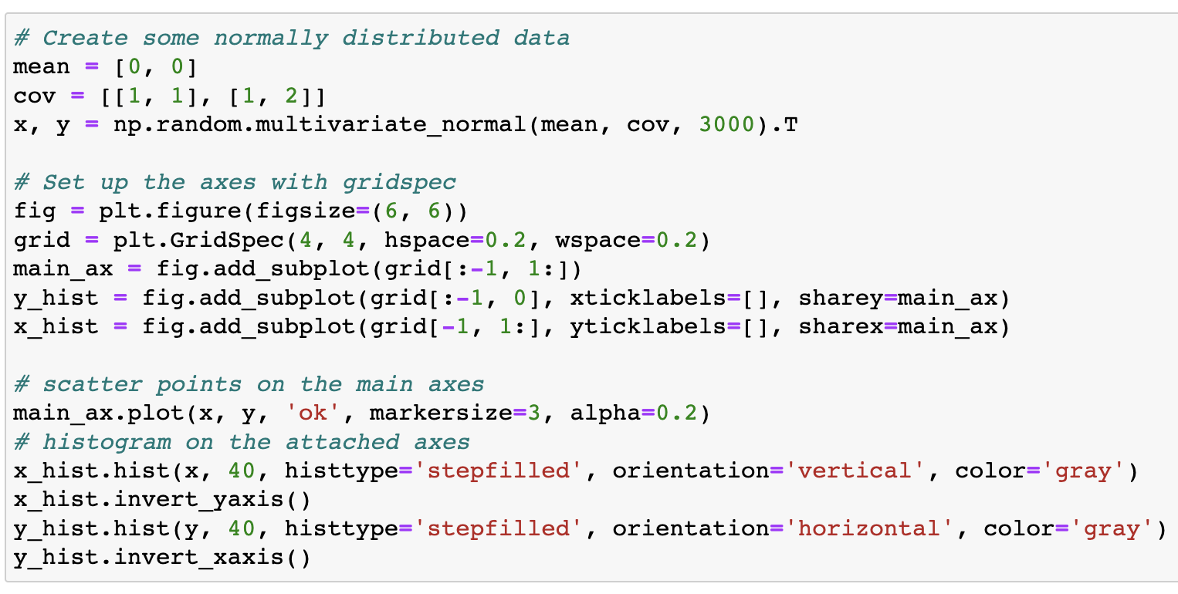
Multiple plots in one figure

Slide 18
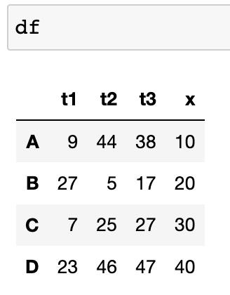
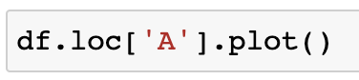
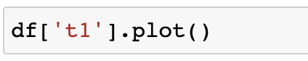
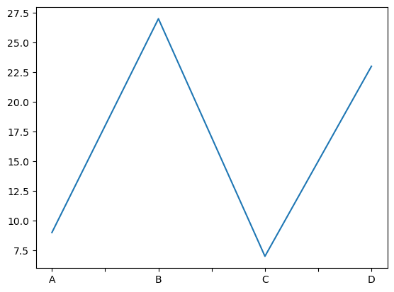
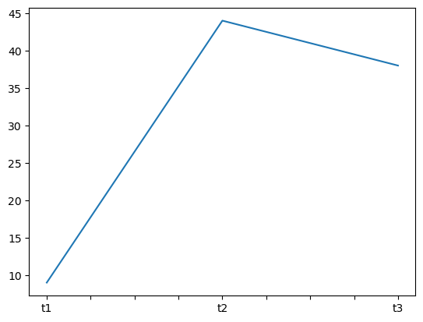
Plotting with Pandas
Both the Pandas Series and DataFrame objects support a plot method.
The plot method on Series and DataFrame is just a simple wrapper around plt.plot():
https://pandas.pydata.org/pandas-docs/stable/reference/api/pandas.DataFrame.plot.html

Slide 19
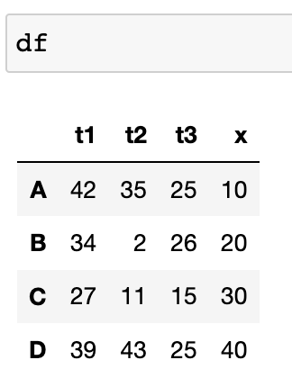
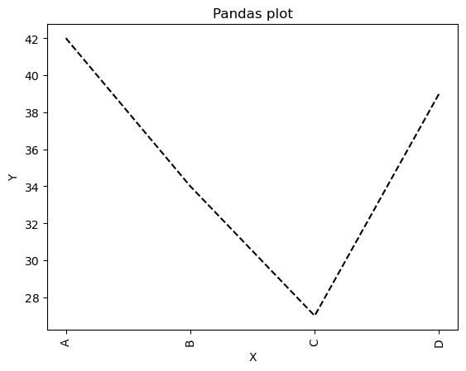
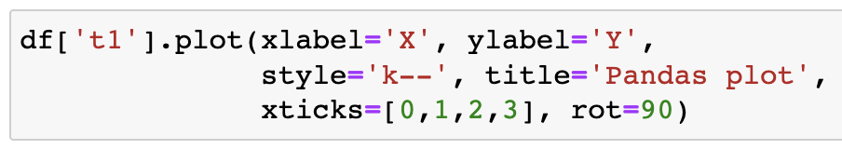
Plotting with Pandas
Both the Pandas Series and DataFrame objects support a plot method.
The plot method on Series and DataFrame is just a simple wrapper around plt.plot():
https://pandas.pydata.org/pandas-docs/stable/reference/api/pandas.DataFrame.plot.html

Slide 20
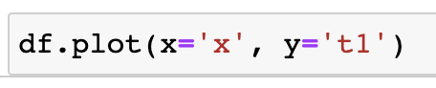
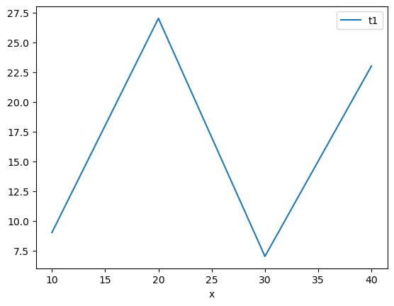
Plotting with Pandas
You can plot one column versus another using the x and y keywords in plot():

Slide 21
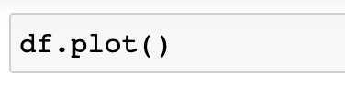
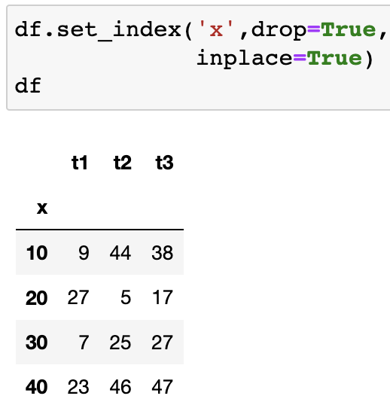
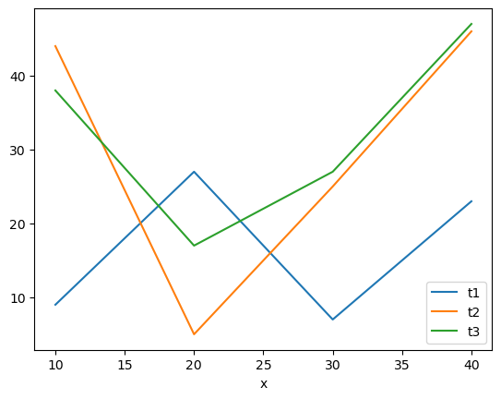
Plotting with Pandas
On DataFrame, plot() is a convenience to plot all of the columns with labels:

Slide 22
Plotting with Pandas
Plotting methods allow for a handful of plot styles other than the default line plot. These methods can be provided as the kind keyword argument to plot(), and include:
‘bar’ or ‘barh’ for bar plots
‘hist’ for histogram
‘box’ for boxplot
‘kde’ or ‘density’ for density plots
‘area’ for area plots
‘scatter’ for scatter plots
‘hexbin’ for hexagonal bin plots
‘pie’ for pie plots

Slide 23
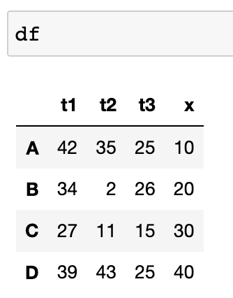
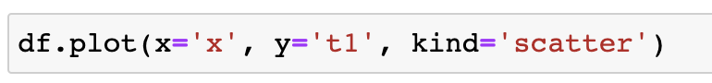
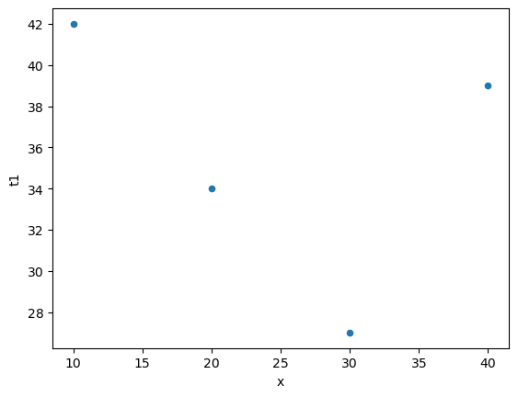
Plotting with Pandas

Slide 24
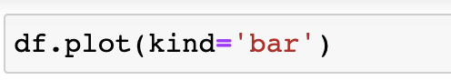
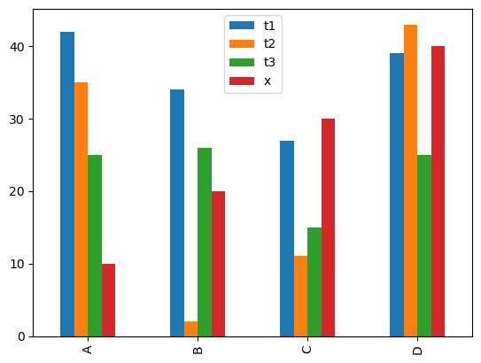
Plotting with Pandas

Slide 25
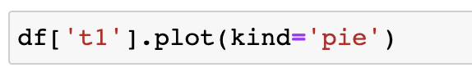
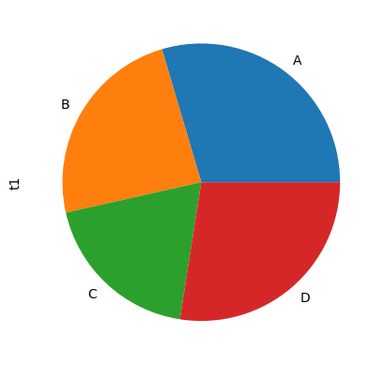
Plotting with Pandas

Slide 26
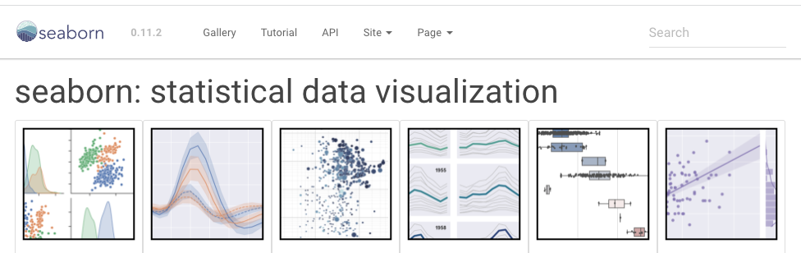
Seaborn
https://seaborn.pydata.org/
Seaborn is a library for making statistical graphics in Python. It builds on top of matplotlib and integrates closely with pandas data structures.
If matplotlib “tries to make easy things easy and hard things possible”, seaborn tries to make a well-defined set of hard things easy too.

Slide 27
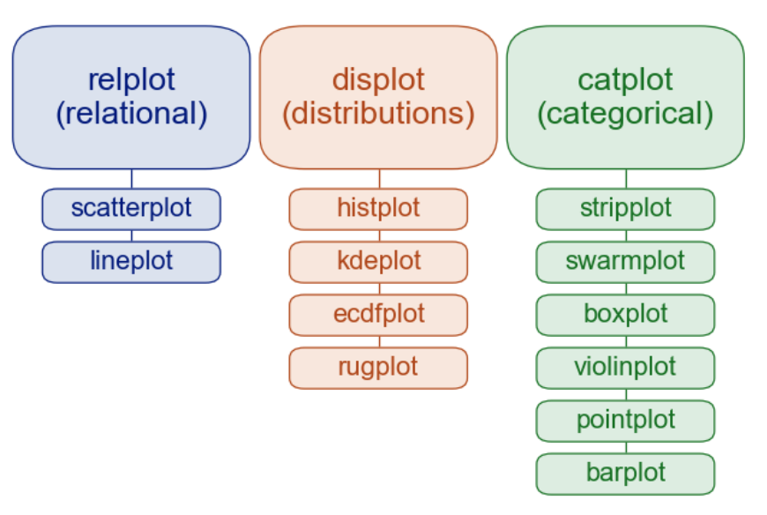
Seaborn plot types
Figure-level
Axes-level

Slide 28
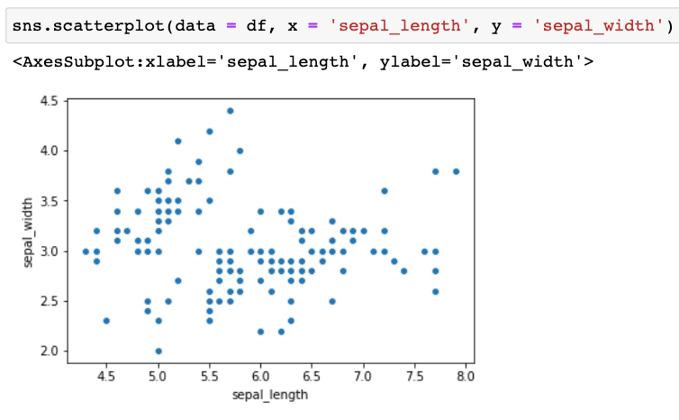
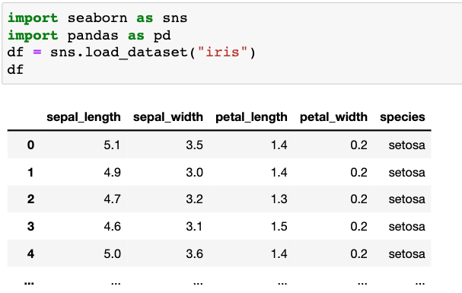
Relational plots
sns.scatterplot()
data: DataFrame or numpy.ndarray
x: column name for the x axis
y: column name for the y axis

Slide 29
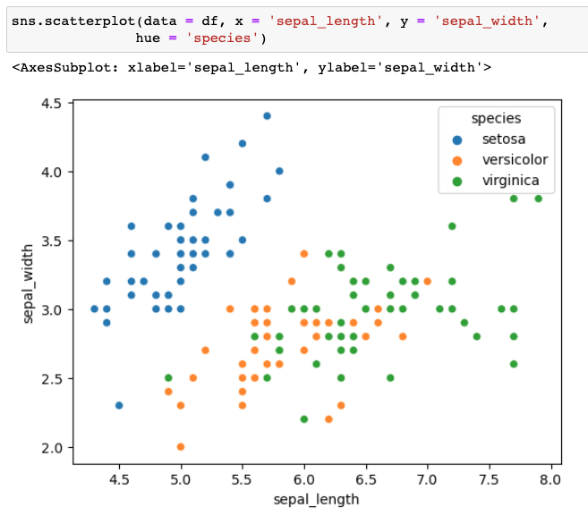
Relational plots
Adding styles and colors
hue : name of variables in ``data`` or vector data; Grouping variable that will produce points with different colors.

Slide 30
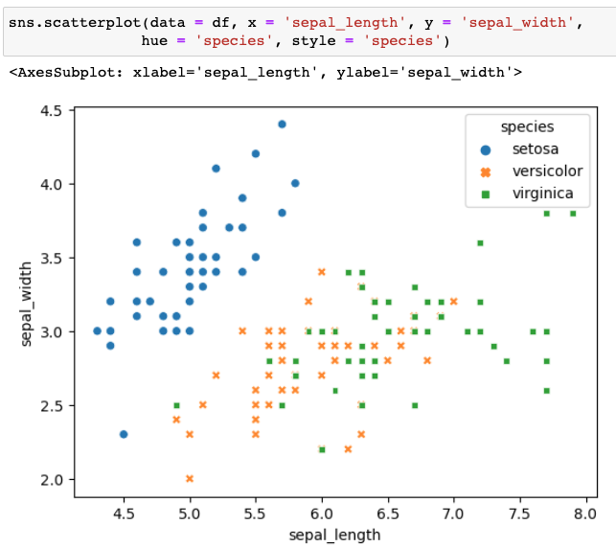
Relational plots
Adding styles and colors
style: name of variables in ``data`` or vector data,Grouping variable that will produce points with different markers.

Slide 31
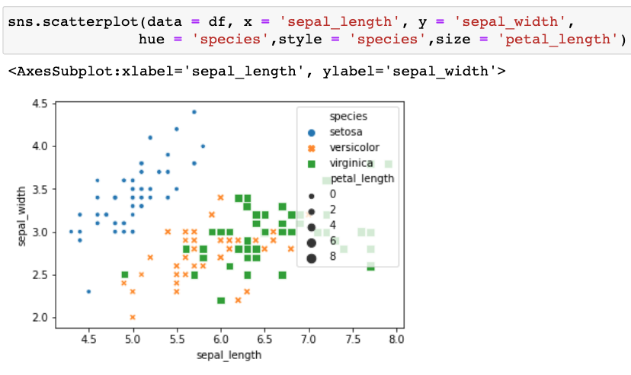
Relational plots
Adding styles and colors
size : name of variables in ``data`` or vector data; Grouping variable that will produce points with different sizes.

Slide 32

Relational plots
sns.lineplot()
By default, the plot aggregates over multiple y values at each value of x and shows an estimate of the central tendency and a confidence interval for that estimate.
ci : int or "sd" or None, optional Size of the confidence interval to draw when aggregating with an estimator. "sd" means to draw the standard deviation of the data. Setting to ``None`` will skip bootstrapping.

Slide 33

Relational plots
sns.lineplot()
ci : int or "sd" or None, optional Size of the confidence interval to draw when aggregating with an estimator. "sd" means to draw the standard deviation of the data. Setting to ``None`` will skip bootstrapping.
Default: 95

Slide 34

Relational plots
sns.lmplot()
Plot data and regression model fits

Slide 35
Seaborn plot types
Figure-level
Axes-level

Slide 36

Categorical plots
sns.boxplot()

Slide 37

Categorical plots
sns.violinplot()

Slide 38

Categorical plots
sns.violinplot()
inner : {"box", "quartile", "point", "stick", None}, optional Representation of the datapoints in the violin interior. If ``box``, draw a miniature boxplot. If ``quartiles``, draw the quartiles of the distribution. If ``point`` or ``stick``, show each underlying datapoint.

Slide 39

Categorical plots
sns.violinplot()
scale : {“area”, “count”, “width”}, optional; The method used to scale the width of each violin.
If ``area``, each violin will have the same area.
If ``count``, the width of the violins will be scaled by the number of observations in that bin.
If ``width``, each violin will have the same width.
Default ‘area’

Slide 40

Categorical plots
sns.stripplot()
A strip plot can all observations and their distribution

Slide 41

Categorical plots
sns.swarmplot()
Similar to stripplot, but the points are adjusted (only along the categorical axis) so that they don't overlap. This gives a better representation of the distribution of values,

Slide 42

Categorical plots
sns.pointplot()
A point plot shows mean +/- error

Slide 43

Categorical plots
sns.pointplot()
ci : int or "sd" or None, optional Size of the confidence interval to draw when aggregating with an estimator. "sd" means to draw the standard deviation of the data. Setting to ``None`` will skip bootstrapping.
Default: 95

Slide 44

Categorical plots
sns.barplot()

Slide 45

Categorical plots
sns.countplot()
Show the counts of observations in each categorical bin using bars.

Slide 46

Distribution plots
sns.histplot()
Plot univariate or bivariate histograms to show distributions of datasets.

Slide 47

Distribution plots
sns.histplot()
Change bin numbers

Slide 48

Distribution plots
sns.histplot()
Plot univariate or bivariate histograms to show distributions of datasets.
Color by categories

Slide 49

Distribution plots
sns.histplot()
Plot univariate or bivariate histograms to show distributions of datasets.
Change from a bar plot to a step plot
element : {"bars", "step", "poly"} Visual representation of the histogram statistic.

Slide 50

Distribution plots
sns.kdeplot()
Rather than using discrete bins, a Kernel density estimation (KDE) plot smooths the observations with a Gaussian kernel, producing a continuous density estimate:

Slide 51

Distribution plots
sns.kdeplot()
Rather than using discrete bins, a Kernel density estimation (KDE) plot smooths the observations with a Gaussian kernel, producing a continuous density estimate.
Color by categories

Slide 52

Distribution plots
sns.kdeplot()
Rather than using discrete bins, a Kernel density estimation (KDE) plot smooths the observations with a Gaussian kernel, producing a continuous density estimate.
fill: fill in the area under the curves

Slide 53

Distribution plots
sns.kdeplot()
Rather than using discrete bins, a Kernel density estimation (KDE) plot smooths the observations with a Gaussian kernel, producing a continuous density estimate.
bivariate distribution

Slide 54

Distribution plots
sns.kdeplot()
Rather than using discrete bins, a Kernel density estimation (KDE) plot smooths the observations with a Gaussian kernel, producing a continuous density estimate.
bivariate distribution

Slide 55


Distribution plots
sns.jointplot()
Draw a plot of two variables with bivariate and univariate graphs.

Slide 56


Distribution plots
sns.pairplot()
Plot pairwise relationships in a dataset.
kind : {'scatter', 'kde', 'hist', 'reg’}
Kind of plot to make
Default: ’scatter’

Slide 57


Distribution plots
sns.pairplot()
Plot pairwise relationships in a dataset.
kind : {'scatter', 'kde', 'hist', 'reg’}
Kind of plot to make
Default: ’scatter’

Slide 58



Heatmap
Plot rectangular data as a color-encoded matrix.

Slide 59


Heatmap
Plot rectangular data as a color-encoded matrix.
vmin, vmax : floats, optional
Values to anchor the colormap,

Slide 60


Heatmap
Plot rectangular data as a color-encoded matrix.
robust : bool, optional If True and ``vmin`` or ``vmax`` are absent, the colormap range is computed with robust quantiles instead of the extreme values.

Slide 61


Heatmap
Plot rectangular data as a color-encoded matrix.
Change colormaps

Slide 62

Colormaps for Matplotlib and Seaborn
https://matplotlib.org/2.1.1/tutorials/colors/colormaps.html#sphx-glr-tutorials-colors-colormaps-py

Slide 63

Colormaps for Matplotlib and Seaborn
https://matplotlib.org/2.1.1/tutorials/colors/colormaps.html#sphx-glr-tutorials-colors-colormaps-py

Slide 64


Heatmap
Plot rectangular data as a color-encoded matrix.
center : float, optional The value at which to center the colormap when plotting divergent data.

Slide 65


Clustermap
Plot a matrix dataset as a hierarchically-clustered（层次聚类） heatmap.

Slide 66


clustermap
Plot a matrix dataset as a hierarchically-clustered heatmap.
metric : str, optional Distance metric to use for the data.
e.g. ‘euclidean’, ‘correlation’
default: euclidean

Slide 67

clustermap
Plot a matrix dataset as a hierarchically-clustered heatmap.
metric : str, optional Distance metric to use for the data.
e.g. ‘euclidean’, ‘correlation’
default: euclidean

Slide 68


clustermap
Plot a matrix dataset as a hierarchically-clustered heatmap.
z_score : int or None, optional Either 0 (rows) or 1 (columns). Whether or not to calculate z-scores for the rows or the columns.
Z scores are: z = (x - mean)/std, so values in each row (column) will get the mean of the row (column) subtracted, then divided by the standard deviation of the row (column).
This ensures that each row (column) has mean of 0 and variance of 1.

Slide 69


Multiple subplots
Method1: using plt.subplots()

Slide 70
Multiple subplots
Method2: using figure-level plots
Figure-level
Axes-level

Slide 71


Multiple subplots
Method2: using figure-level plots
Figure-level interface for drawing relational plots
kind : string; Kind of plot to draw, corresponding to a seaborn relational plot. Options are {``scatter`` and ``line``}.

Slide 72

Controlling figure styles
sns.set_style(style)
style: There are five preset seaborn styles:
darkgrid, whitegrid, dark, white, and ticks.

Slide 73

Controlling figure styles
sns.set_style(style)
style: There are five preset seaborn styles:
darkgrid, whitegrid, dark, white, and ticks.

Slide 74

Controlling figure styles
Removing axes spines
sns.despine()

Slide 75

Controlling figure styles
axes.set()

Slide 76

Controlling figure styles
Change color palettes

Slide 77


Scaling plot elements
sns.set_context()
The four preset contexts, in order of relative size, are paper, notebook, talk, and poster

